Slide 1

CECS 378 Section 04 Lecture will start shortly…

Slide 2
Computing Security: Principles and Practice CIS Top 20, NIST Security Framework & MITRE ATT&CK and Shield Frameworks March 22nd & 24th, 2021 CECS 378 - Spring 2021

Slide 3
CIS Top 20 Controls - Background
CIS - Center for Internet Security
The CIS Controls are a prioritized set of actions that collectively form a defense-in-depth set of best practices that mitigate the most common attacks against systems and networks.
The CIS Controls are developed by a community of IT experts who apply their first-hand experience as cyber defenders to create these globally accepted security best practices.
The CIS Controls are not limited to blocking the initial compromise of systems, but also address detecting already-compromised machines and preventing or disrupting attackers’ follow-on actions.

Slide 4
CIS Top 20 Controls - 5 Principles
The five critical principles of an effective cyber defense system as reflected in the CIS Controls are:
Offense informs defense: Use knowledge of actual attacks that have compromised systems to provide the foundation to continually learn from these events to build effective, practical defenses.
Prioritization: Invest first in Controls that will provide the greatest risk reduction and protection against the most dangerous threat actors and that can be feasibly implemented in your computing environment.
Measurements and Metrics: Establish common metrics to provide a shared language for executives, IT specialists, auditors, and security officials to measure the effectiveness of security measures within an organization so that required adjustments can be identified and implemented quickly.
Notes:
The five critical tenets of an effective cyber defense system as reflected in the CIS Controls are:
Offense informs defense: Use knowledge of actual attacks that have compromised systems to provide the foundation to continually learn from these events to build effective, practical defenses. Include only those controls that can be shown to stop known real-world attacks.
Prioritization: Invest first in Controls that will provide the greatest risk reduction and protection against the most dangerous threat actors and that can be feasibly implemented in your computing environment. The CIS Implementation Groups discussed below are a great place for organizations to start identifying relevant Sub-Controls.
Measurements and Metrics: Establish common metrics to provide a shared language for executives, IT specialists, auditors, and security officials to measure the effectiveness of security measures within an organization so that required adjustments can be identified and implemented quickly.
Continuous diagnostics and mitigation: Carry out continuous measurement to test and validate the effectiveness of current security measures and to help drive the priority of next steps.
Automation: Automate defenses so that organizations can achieve reliable, scalable, and continuous measurements of their adherence to the Controls and related metrics.

Slide 5
CIS Top 20 Controls - 5 Principles (Cont.)
The five critical principles (Cont.):
Continuous diagnostics and mitigation: Carry out continuous measurement to test and validate the effectiveness of current security measures and to help drive the priority of next steps.
Automation: Automate defenses so that organizations can achieve reliable, scalable, and continuous measurements of their adherence to the Controls and related metrics.
Notes:
The five critical tenets of an effective cyber defense system as reflected in the CIS Controls are:
Offense informs defense: Use knowledge of actual attacks that have compromised systems to provide the foundation to continually learn from these events to build effective, practical defenses. Include only those controls that can be shown to stop known real-world attacks.
Prioritization: Invest first in Controls that will provide the greatest risk reduction and protection against the most dangerous threat actors and that can be feasibly implemented in your computing environment. The CIS Implementation Groups discussed below are a great place for organizations to start identifying relevant Sub-Controls.
Measurements and Metrics: Establish common metrics to provide a shared language for executives, IT specialists, auditors, and security officials to measure the effectiveness of security measures within an organization so that required adjustments can be identified and implemented quickly.
Continuous diagnostics and mitigation: Carry out continuous measurement to test and validate the effectiveness of current security measures and to help drive the priority of next steps.
Automation: Automate defenses so that organizations can achieve reliable, scalable, and continuous measurements of their adherence to the Controls and related metrics.

Slide 6
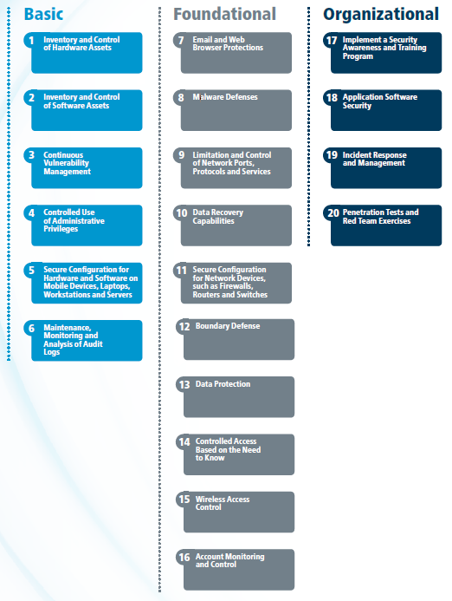
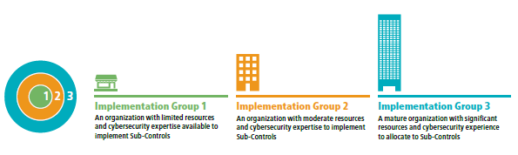
CIS Top 20 Controls - Prioritization
Notes:
Implementation Groups
Historically the CIS Controls utilized the order of the Controls as a means of focusing an organization’s cybersecurity activities, resulting in a subset of the first six CIS Controls referred to as cyber hygiene. However, many of the practices found within the CIS cyber hygiene control set can be difficult for organizations with limited resources to implement. This highlighted a need for a collection of best practices focused on balancing resource constraints and effective risk mitigation. As a result, CIS recommends the following new guidance to prioritize CIS Control utilization, known as CIS Controls Implementation Groups.
The CIS Controls Implementation Groups (IGs) are self-assessed categories for organizations based on relevant cybersecurity attributes. Each IG identifies a subset of the CIS Controls that the community has broadly assessed to be reasonable for an organization with a similar risk profile and resources to strive to implement. These IGs represent a horizontal cut across the CIS Controls tailored to different types of enterprises. Each IG builds upon the previous one. As such, IG2 includes IG1, and IG3 includes all of the CIS Sub-Controls in IG1 and IG2. A resource constrained organization may have to protect critical data and, therefore, implement Sub-Controls in a higher IG. Ultimately, an organization implementing the CIS Sub-Controls defined for their IG is moving toward a standard duty of care as described in the CIS Risk Assessment Method (CIS RAM). CIS RAM is a free resource available at https://learn.cisecurity.org/cis-ram.
CIS recommends that organizations prioritize their implementation of the Controls by following the IGs. Organizations should implement Sub-Controls in IG1, followed by IG2 and then IG3. The Sub-Controls contained within IG1 are essential to success. Implementation of IG1 should be considered among the very first things to be done as part of a cybersecurity program. CIS refers to IG1 as “Cyber Hygiene” – the essential protections that must be put into place to defend against common attacks. Organizations are encouraged to classify themselves as belonging to one of three Implementation Groups. For instance:
• A family-owned business with ~10 employees may self-classify as IG1;
• A regional organization providing a service may classify itself as IG2; or
• A large corporation with thousands of employees may be labeled IG3.

Slide 7
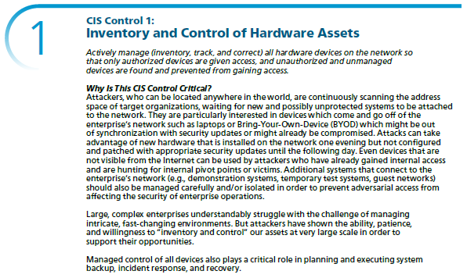
CIS Top 20 Controls - Basic #1

Slide 8
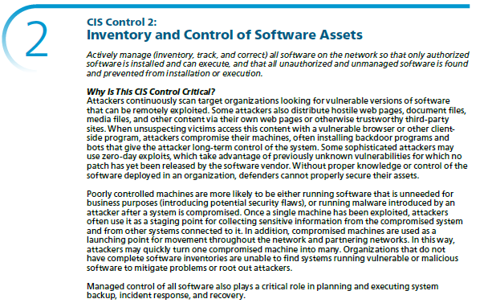
CIS Top 20 Controls - Basic #2

Slide 9
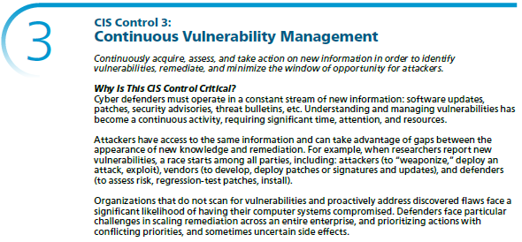
CIS Top 20 Controls - Basic #3

Slide 10
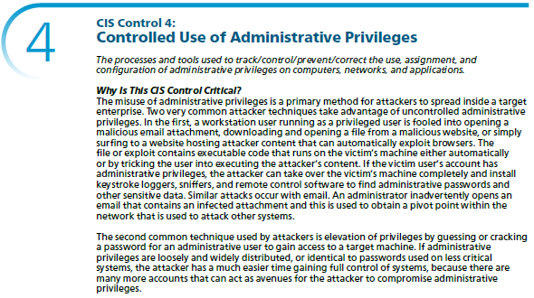
CIS Top 20 Controls - Basic #4

Slide 11
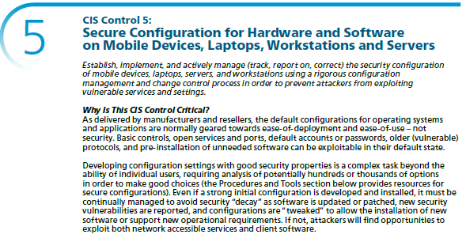
CIS Top 20 Controls - Basic #5

Slide 12
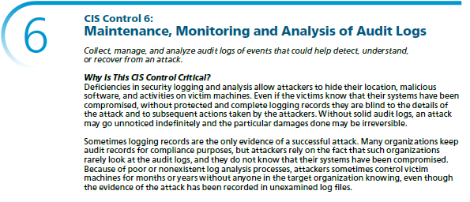
CIS Top 20 Controls - Basic #6

Slide 13
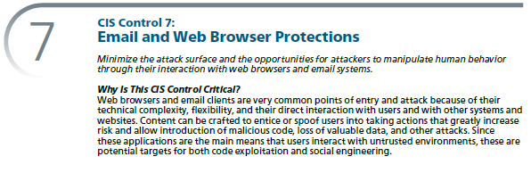
CIS Top 20 Controls - Foundational #7

Slide 14
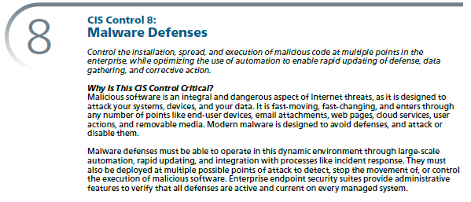
CIS Top 20 Controls - Foundational #8

Slide 15
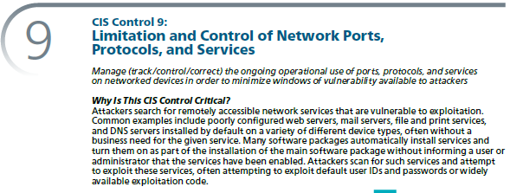
CIS Top 20 Controls - Foundational #9

Slide 16
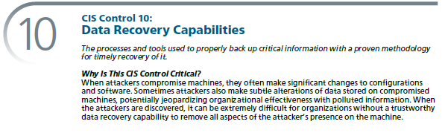
CIS Top 20 Controls - Foundational #10

Slide 17
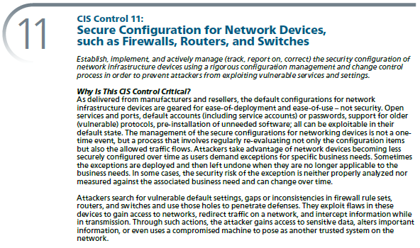
CIS Top 20 Controls - Foundational #11

Slide 18
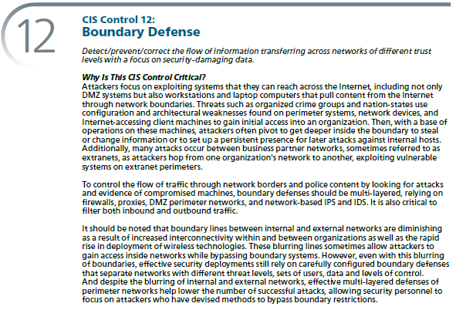
CIS Top 20 Controls - Foundational #12

Slide 19
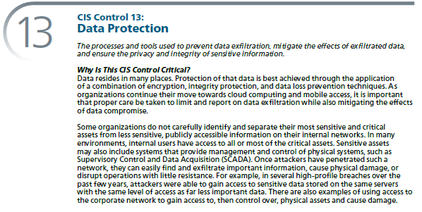
CIS Top 20 Controls - Foundational #13

Slide 20
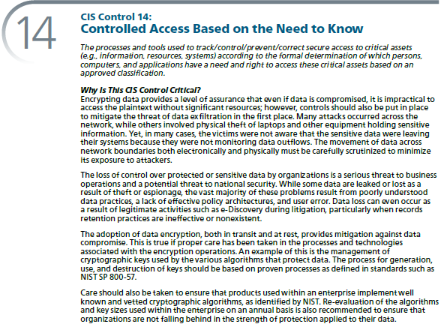
CIS Top 20 Controls - Foundational #14

Slide 21
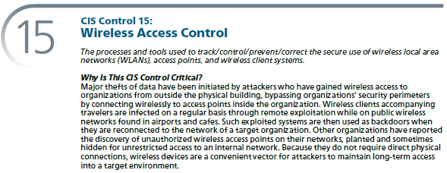
CIS Top 20 Controls - Foundational #15

Slide 22
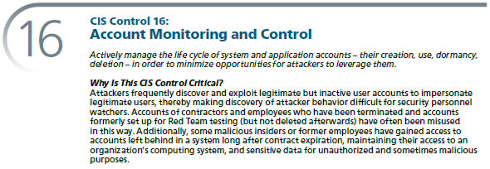
CIS Top 20 Controls - Foundational #16

Slide 23
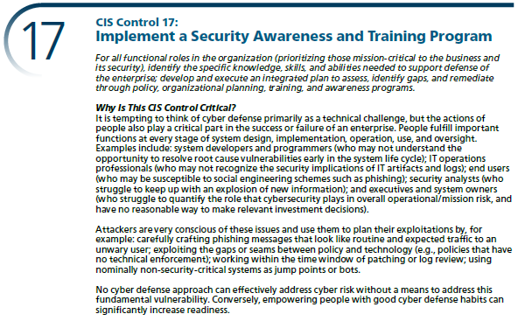
CIS Top 20 Controls - Organizational #17

Slide 24
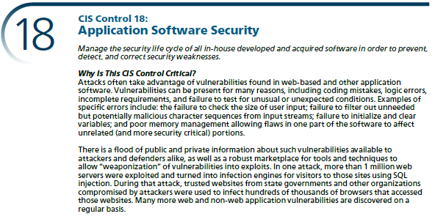
CIS Top 20 Controls - Organizational #18

Slide 25
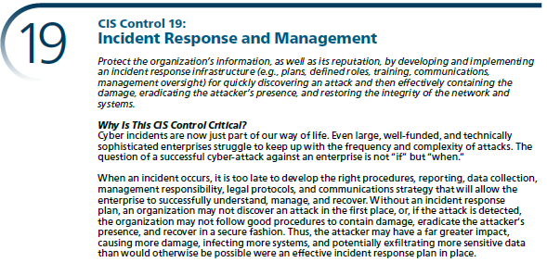
CIS Top 20 Controls - Organizational #19

Slide 26
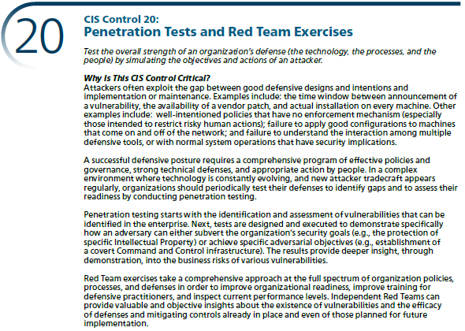
CIS Top 20 Controls - Organizational #20

Slide 27
NIST Cybersecurity Framework - Background
NIST - National Institute of Standards & Technology
The NIST Cybersecurity Framework provides a common language for understanding, managing, and expressing cybersecurity risk to internal and external stakeholders.
It can be used to help identify and prioritize actions for reducing cybersecurity risk, and it is a tool for aligning policy, business, and technological approaches to managing that risk.
It can be used to manage cybersecurity risk across entire organizations, or it can be focused on the delivery of critical services within an organization.

Slide 28
NIST Cybersecurity Framework - Background
The NIST Cybersecurity Framework is composed of 3 parts: the Framework Core, the Framework Implementation Tiers, & the Framework Profiles.
Framework Core provides a set of activities to achieve specific cybersecurity outcomes, and references examples of guidance to achieve those outcomes – Functions, Categories, Sub-Categories, and References
Framework Implementation Tiers provide context on how an organization views cybersecurity risk and the processes in place to manage that risk – Tier 1: Partial, Tier 2: Risk Informed, Tier 3: Repeatable, and Tier 4: Adaptive
Framework Profiles is the alignment of the Functions, Categories, and Subcategories with the business requirements, risk tolerance, and resources of the organization – Used to describe the current state or the desired target state of specific cybersecurity activities.

Slide 29
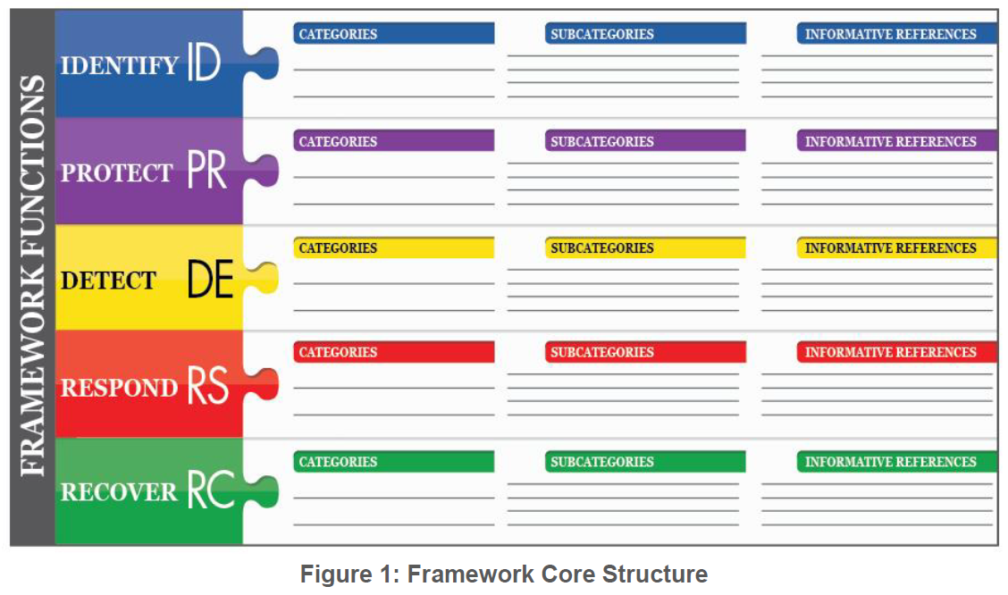
NIST Cybersecurity Framework

Slide 30
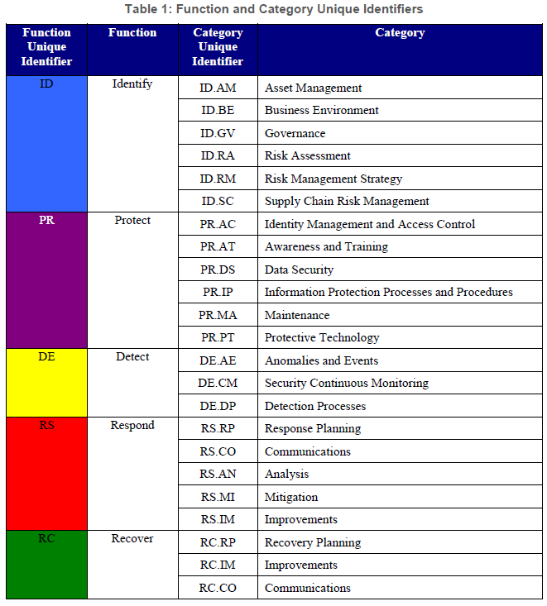
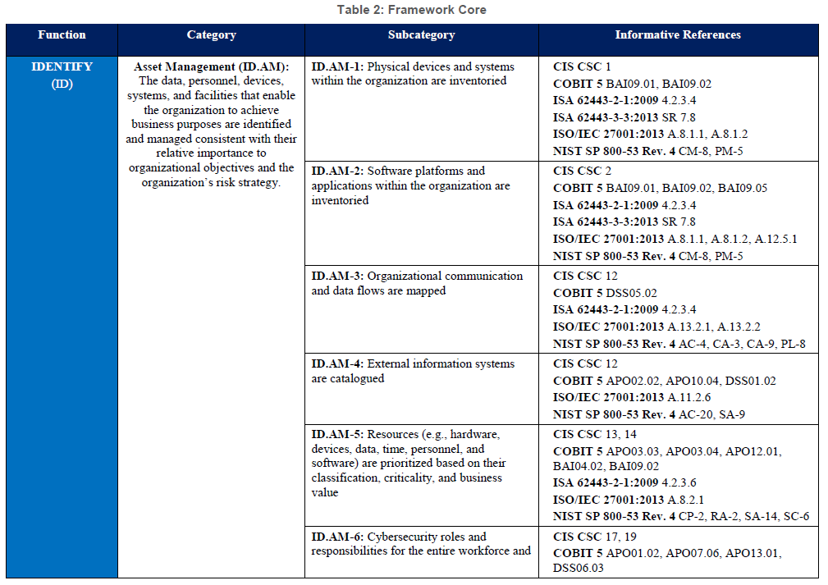
NIST Cybersecurity Framework

Slide 31
MITRE ATT&CK Framework - Background
ATT&CK – Adversary Tactics, Techniques & Common Knowledge
Mitre ATT&CK is a knowledge base and model for cyber adversary behavior, reflecting the various phases of an adversary’s attack lifecycle and the platforms they are known to target.
The first ATT&CK model was created in September 2013

Slide 32
MITRE ATT&CK Framework - Use Cases
Adversary Emulation - create adversary emulation scenarios to test & verify defenses
Red Teaming - create red team plans & organize operations to avoid certain defensive measures
Behavioral Analytics Development - construct and test behavioral analytics to detect adversarial behavior within an environment
Defensive Gap Assessment - adversary model to assess tools, monitoring, & mitigations of existing defenses within an organization’s enterprise
SOC Maturity Assessment - determine how effective a Security Operations Center is at detecting, analyzing, and responding to intrusions
Cyber Threat Intelligence Enrichment - understanding & documenting adversary group profiles from a behavioral perspective

Slide 33
MITRE ATT&CK Framework - 12 Tactics
Initial Access - techniques that use various entry vectors to gain their initial foothold within a network
Execution - techniques that result in adversary-controlled code running on a local or remote system
Persistence - techniques that adversaries use to keep access to systems across restarts, changed credentials, and other interruptions that could cut off their access
Privilege Escalation - techniques that adversaries use to gain higher-level permissions on a system or network
Defense Evasion - techniques that adversaries use to avoid detection throughout their compromise
Credential Access - techniques for stealing credentials like account names and passwords
Discovery - techniques an adversary may use to gain knowledge about the system and internal network
Lateral Movement - techniques that adversaries use to enter and control remote systems on a network
Collection - techniques adversaries may use to gather information and the sources information is collected from that are relevant to following through on the adversary's objectives
Command and Control - techniques that adversaries may use to communicate with systems under their control within a victim network
Exfiltration - techniques that adversaries may use to steal data from your network
Impact - techniques that adversaries use to disrupt availability or compromise integrity by manipulating business & operational processes

Slide 34
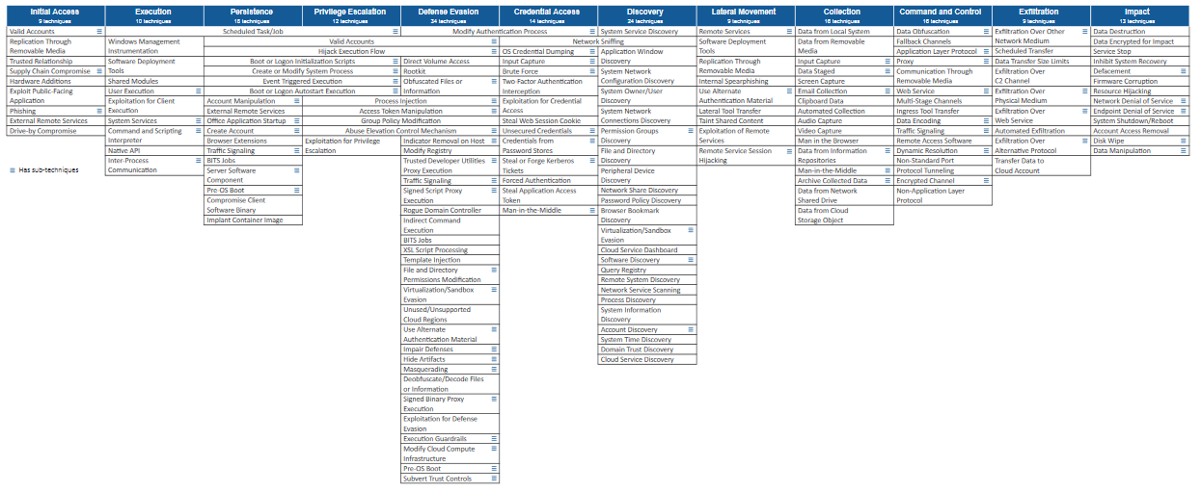
MITRE ATT&CK Framework - 178 Techniques
https://attack.mitre.org/matrices/enterprise/

Slide 35
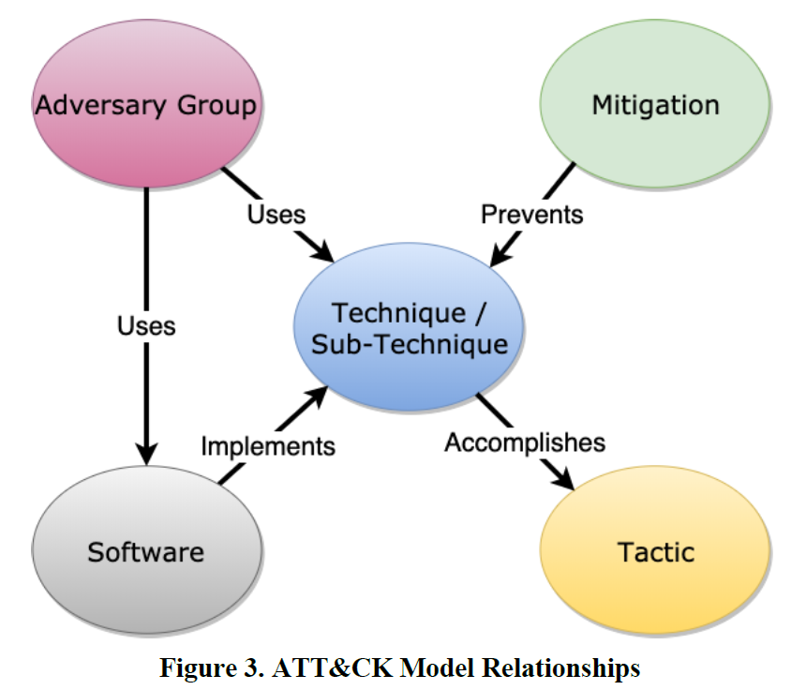
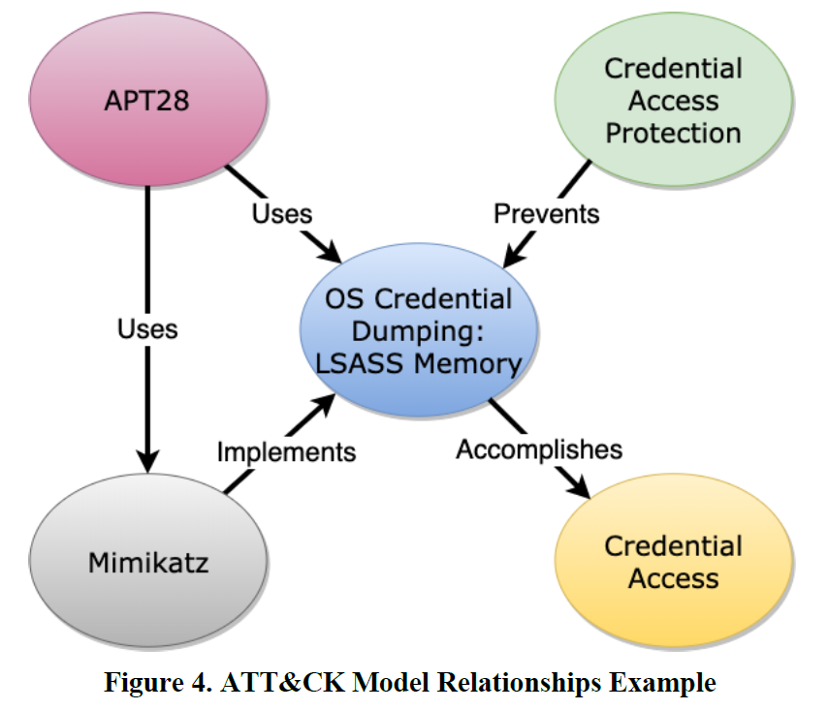
MITRE ATT&CK Framework

Slide 36
MITRE Shield Framework - Background
MITRE Shield is a knowledge base designed to give defenders tools that can be used to counter cyber adversaries.
Shield includes a database of techniques a defender can use to mount an active defense.
The knowledge base also describes a number of tactics common to defensive plans.
It then maps the tactics to the activities that may help achieve them.

Slide 37
MITRE Shield Framework - 8 Tactics
Channel - Guide an adversary down a specific path or in a specific direction.
Collect - Gather adversary tools, observe tactics, and collect other raw intelligence about the adversary's activity.
Contain - Prevent an adversary from moving outside specific bounds or constraints.
Detect - Establish or maintain awareness into what an adversary is doing.
Disrupt - Prevent an adversary from conducting part or all of their mission.
Facilitate - Enable an adversary to conduct part or all of their mission.
Legitimize - Add authenticity to deceptive components to convince an adversary that something is real.
Test - Determine the interests, capabilities, or behaviors of an adversary.

Slide 38
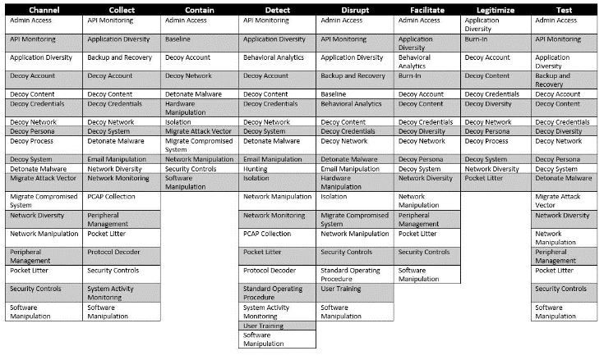
MITRE Shield Framework - 8 Tactics
•Tactics, denoting what the defender is trying to accomplish(the columns)
•Techniques, describing how the defense achieves the tactic(s)(the individual cells)

Slide 39
CECS 378 Section 04 Lab has begun, if you have a question please unmute yourself and use the audio within Zoom

